Slide 1
Denny Zhou Talk
Wang Zicong
3/12/2025

Slide 2
little expectation for AI
AI should be able to learn from just a few examples, like what humans usually do
Instead of solving hradest math problems that humans cannot solve or AGI

Slide 3
Current ML Approaches
Current ML models, like semi-supervised learning, Bayesian nonparametrics, and kernel machines, require vast amounts of data to learn tasks that humans can perform with little data. This leads to a discussion of the lack of reasoning abilities in traditional ML models.
Reasonging is missing in ML. Humans can learn from just a few examples beacuse humans can reason

Slide 4
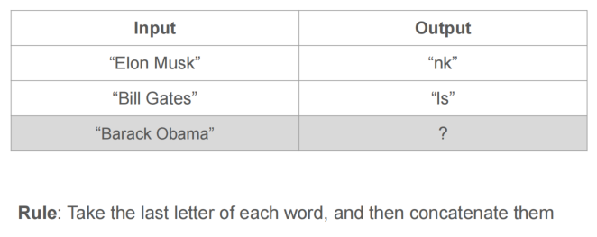
Toy problem: Last Letter Concatenation

Slide 5
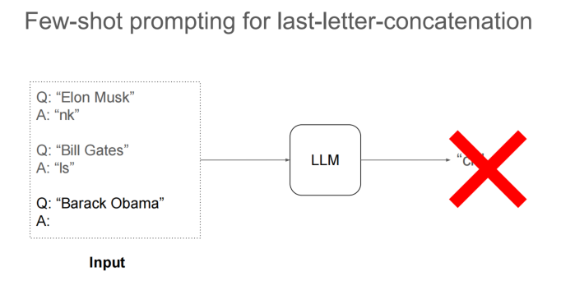
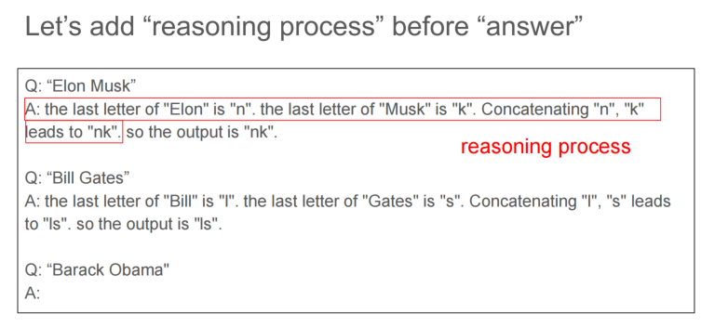
Key idea: Derive the final answer through intermediate steps

Slide 6
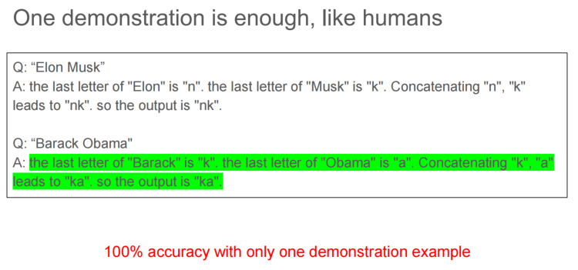

Slide 7
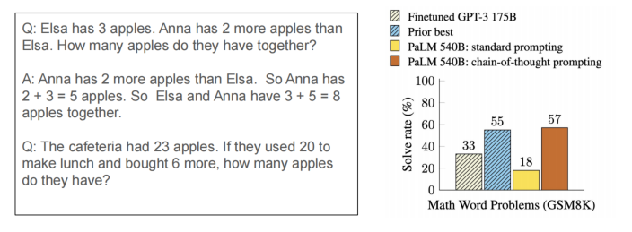
Chain-of-Thought prompting(neurips2022)
The use of intermediate reasoning steps --chains of thought-- provided with in the model’s input. Prompting with Intermediate Steps
arithmetic reasoning
commonsense reasoning
symbolic reasoning(like string maniplulation)

Slide 8
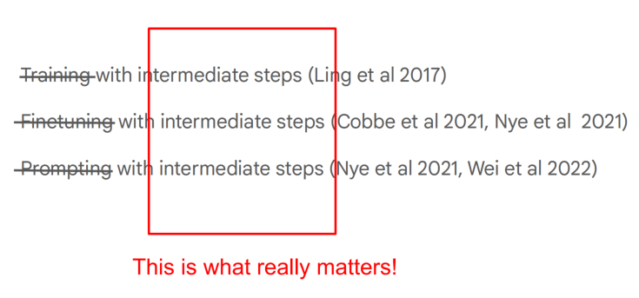

Slide 9
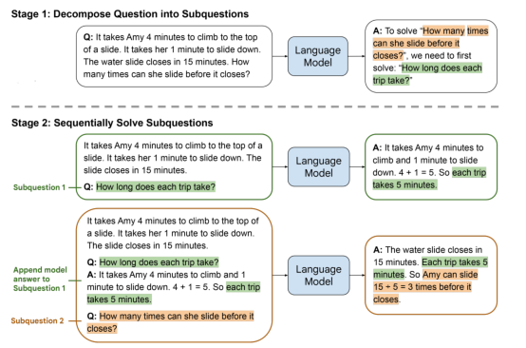
Least-to-Most Prompting(ICLR2023)
add reasoning strategies in few-shot example
Enable easy-to-hard generalization by decomposition

Slide 10
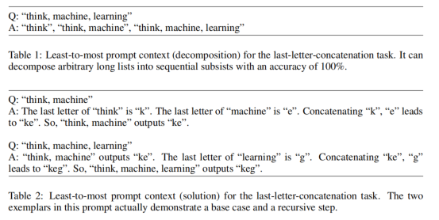

Examples
last-letter-concatenation

Slide 11
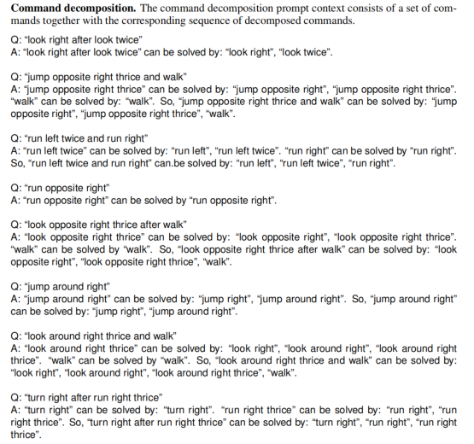
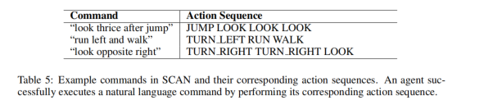

Examples
Compositional Generalization(SCAN)

Slide 12
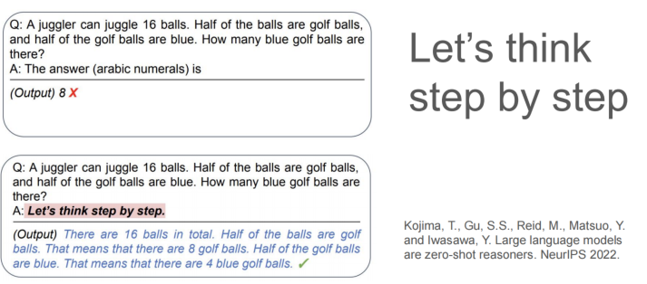
zero-shot Cot(let's think step by step)
zero-shot is cool but usually significatnly worse than few-shot

Slide 13
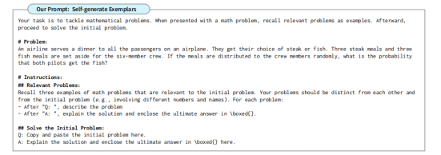
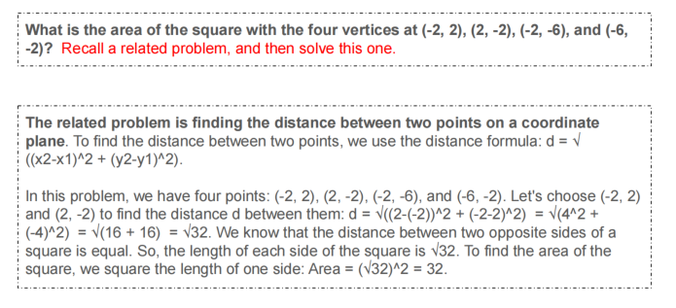
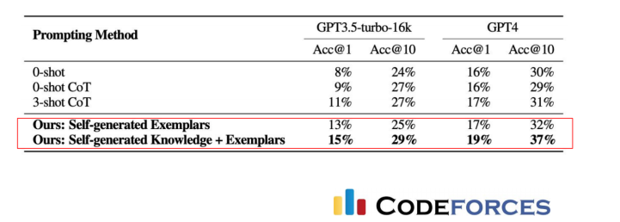
LLM as Analogical Reasoner(ICLR2024)
self-generation of relevant examples
self-generation of knowledge
problem-solving

Slide 14
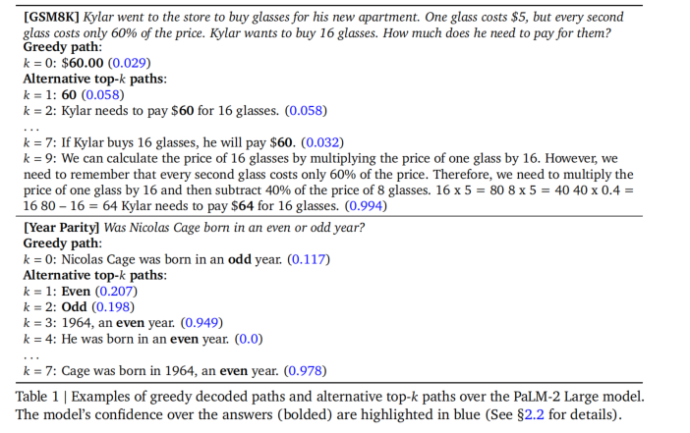
Chain-of-thought reasoning without prompting(neurips2024)
CoT decoding
key finding:(no greedy decoding)
LLMs indeed cannot reason if we
only consider the greedy decoding path.
LLMs can reason if we consider
the alternative decoding paths.

Slide 15
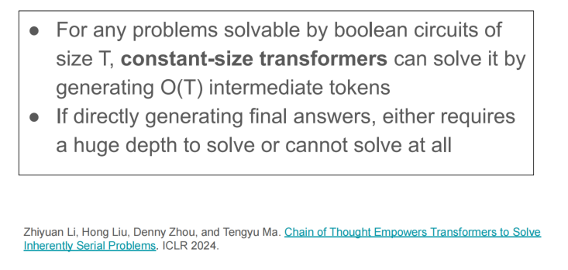
Scaling chain-of-thought by generating more intermediate tokens.(ICLR 2024)

Slide 16
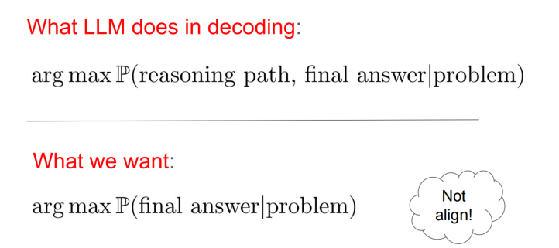
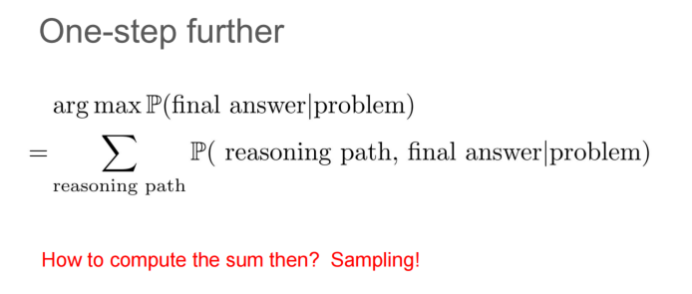

Slide 17
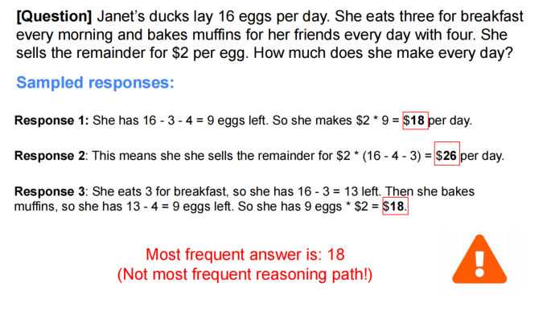
Self-Consistency(ICLR2023)
More consistent, more likely to be correct

Slide 18
Quiz
[Q1] When the LLM outputs a direct answer without intermediate
steps, will you still sample several times, and then choose the most common answer?
[Q2] Change self-consistency by letting LLM generate multiple
responses, instead of sampling multiple times, and then choosing
the most common answer. Does this make sense?

Slide 19
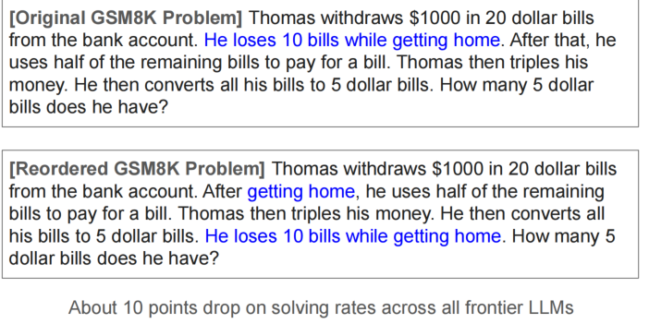
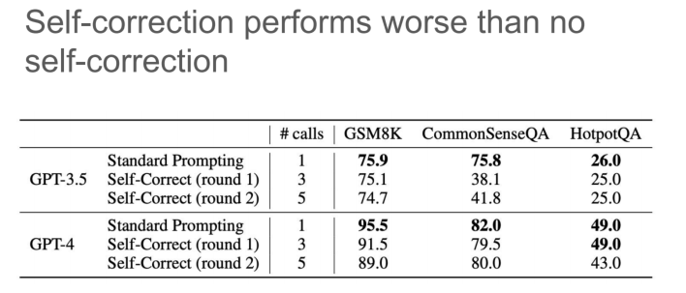
Limitations
irrelevant context
llm cannot self-correct yet
(Needs orcale, e.g. debuggging)
premise order

Slide 20
Summary
Generating intermediate steps improves LLM reasoning
training/finetuning/prompting with intermediate steps
zero-shot, analogical reasoning, Cot decoding
Self-consistency greately improves CoT reasoning
Limiitation: irrelevant context, self-correction, premise-order

